Slide 1

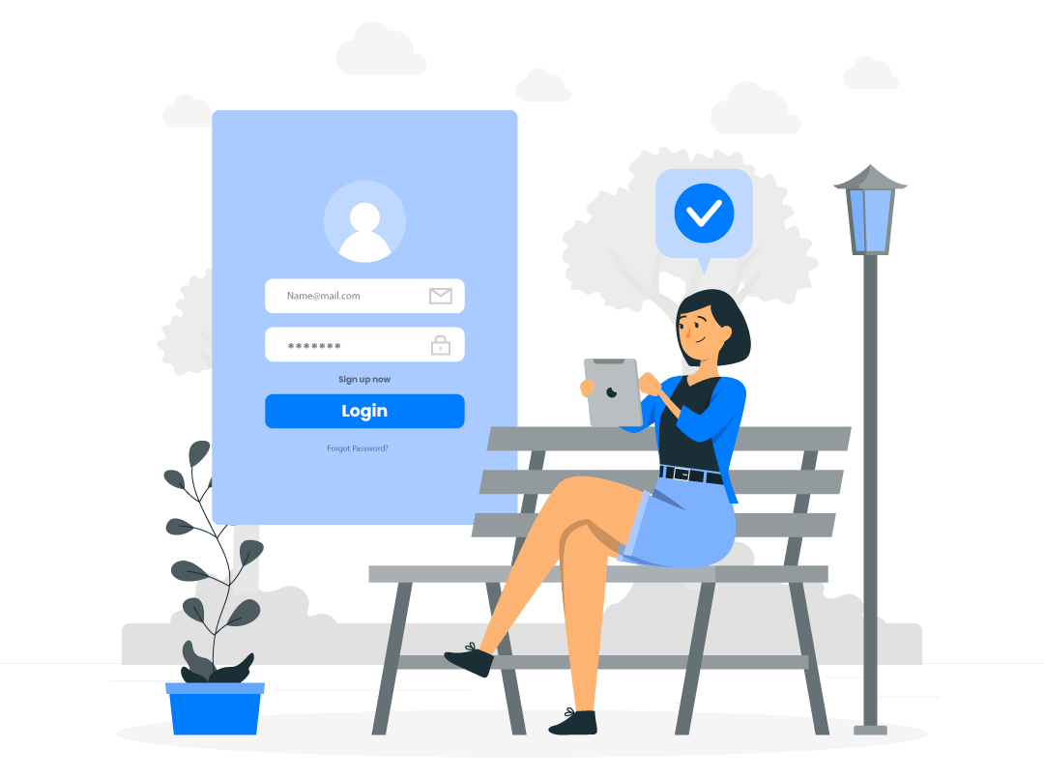

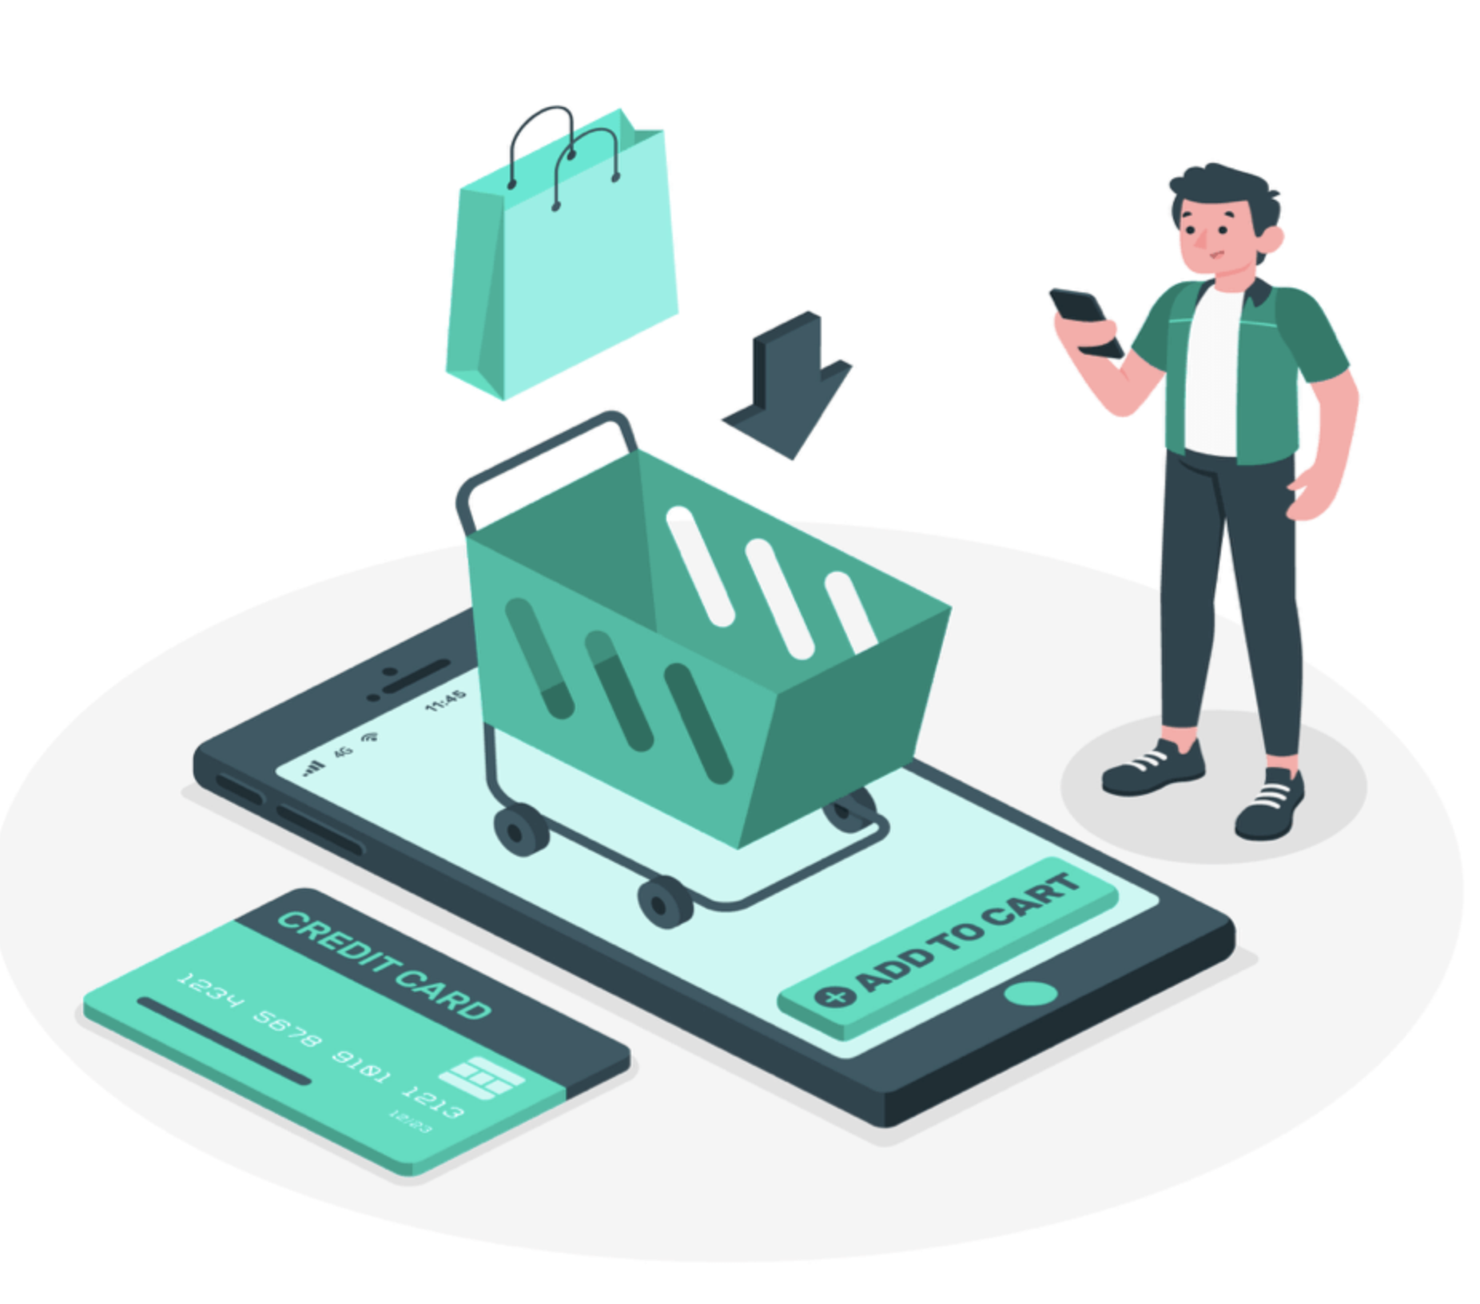
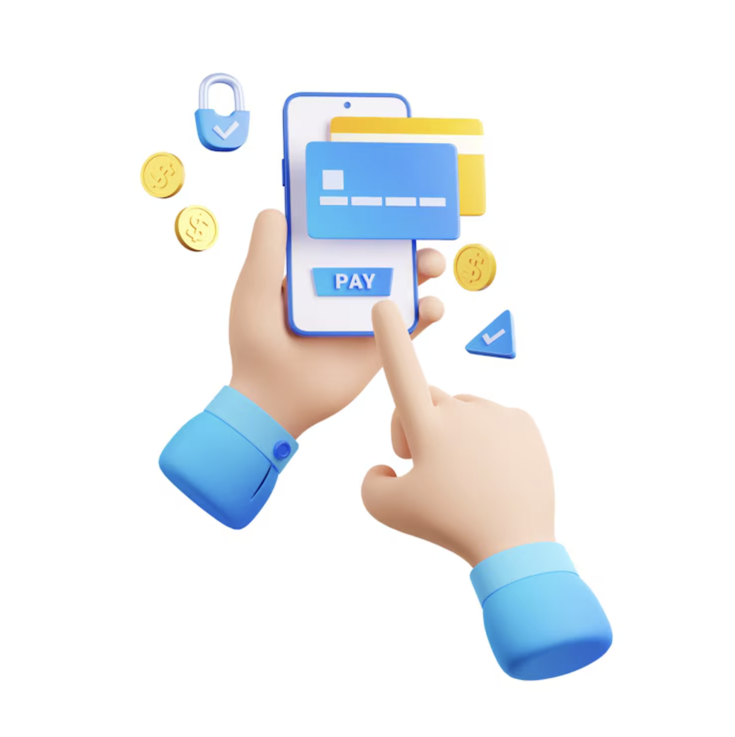

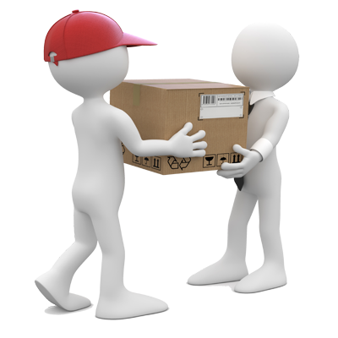
How to
SHOP ONLINE ON OUR WEBSITE
E-COMMERCE PROJECT
22 April, 2025
LOG IN TO YOUR ACCOUNT
CHOOSE THE ITEM YOU LIKE
ADD TO CART
MAKE PAYMENT
PAYMENT SUCCESSFULL
PACKAGE SENT TO YOUR ADDRESS
www.globus.com

Slide 2






MEET Our Team
Abdur Rahman Sifat
Sajidul Islam Samim
Mridul Hasan
Mahdi al Mahmud
Shahriar Hossain
Rubayet Ferdous
www.globus.com

Slide 3
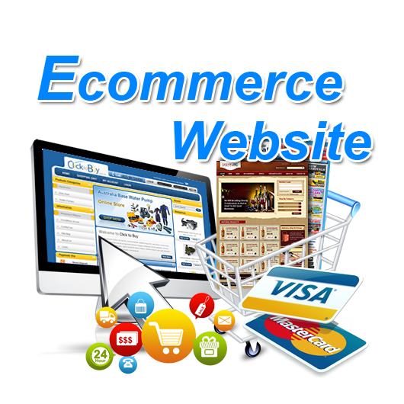
TABELS OF
CONTENT
1.
Our team
2.
Introduction
3.
Motivation
4.
Vision and Mission
5.
Feature list
6.
Tools an Technology
7.
use case diagram
8.
data flow diagrams
www.globus.com

Slide 4

INTRODUCTION
Today, we're diving into the world of e-commerce websites. We'll be discussing what they are, how they work, and what makes them so important in today's digital marketplace. Let's get started.
www.globus.com

Slide 5

MARKET Research
The global e-commerce market was valued at approximately USD 11.04 trillion in 2021.
It is projected to reach around USD 28.02 trillion by 2028.
E-commerceDB.Com estimates that Bangladesh will generate US$7,520.3 million in 2023, with a projected market volume of $13,502.8 by 2026.
www.globus.com

Slide 6

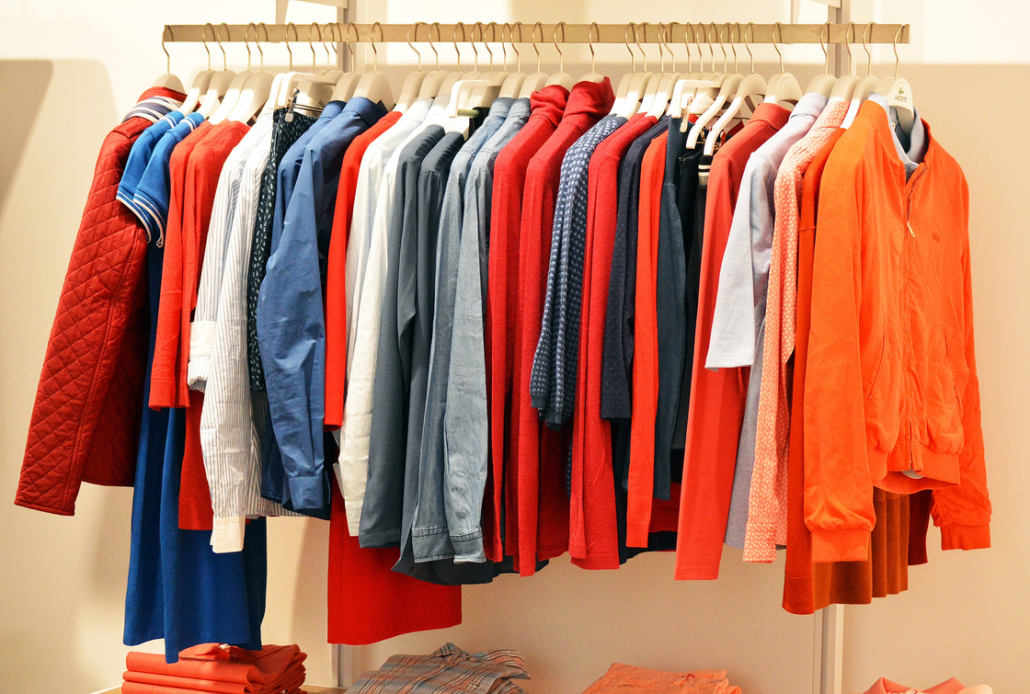
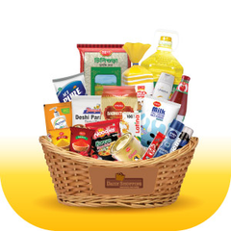
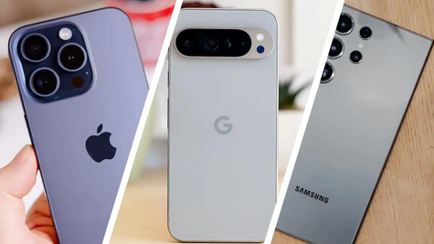

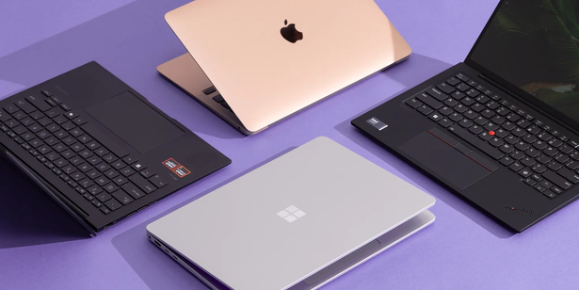
MOTIVATION
Innovate, create, and make an impact—this project is our step toward excellence!
"Passion, dedication, and hard work—driving this project to success!"
www.globus.com
www.globus.com

Slide 7

VISION AND MISSION
Vision:
To lead in online commerce, empowering people to discover and acquire desired products and services.
Mission:
To provide a user-friendly, secure platform for easy browsing, purchasing, and order management.
www.globus.com

Slide 8
FEATURE LIST
Core E-Commerce Features
1.Product Catalog
2.Search Functionality
3.Shopping Cart
4.Checkout Process
User Account Features
1.Authentication
2.User Dashboard
and Payment & Shipping, Admin Panel, Marketing & Engagement Customer Service,
www.globus.com

Slide 9
INTERVIEW SAMPLE QUESTIONS
What are the key components of an eCommerce website?​​
How would you ensure a smooth checkout process?​​
What KPIs would you track to measure eCommerce performance?​​
What’s the difference between a marketplace and a traditional eCommerce site?​
How would you handle seasonal sales or flash deals technically?​
www.globus.com

Slide 10






TOOLS AN TECHNOLOGY
www.globus.com

Slide 11



DIAGRAM
DFD:- drive_link
CLIKE HERE
Use Case:- drive_link
CLIKE HERE
www.globus.com

Slide 12
THANK YOU
reallygreatsite.com

Slide 13

Any Questions ?

